Slide 1
AZ-400.00 Learning Path 01: Implement development for enterprise DevOps

Slide 2
Module 01: Introduction to DevOps

Slide 3
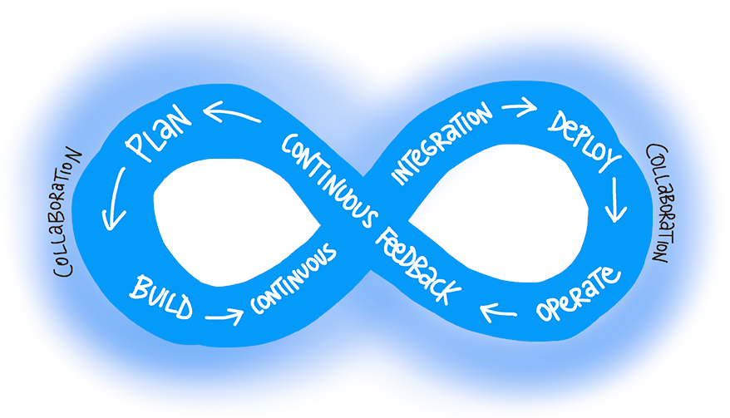
What is DevOps?
“DevOps is the union of people, process, and products to enable continuous delivery of value to end users.”
— Donovan Brown,
What is DevOps?
Notes:
https://docs.microsoft.com/en-us/azure/devops/learn/what-is-devops

Slide 4
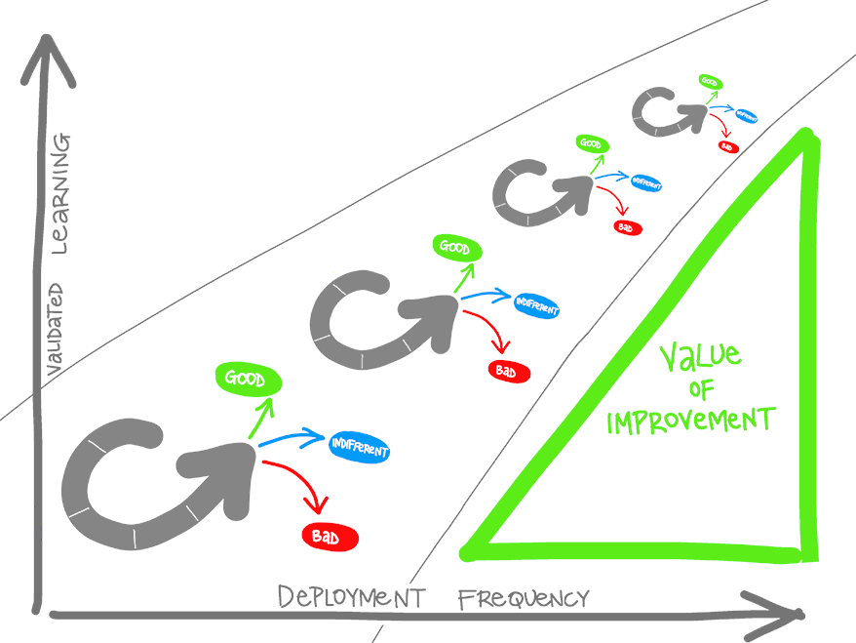
What is DevOps? (continued)
Understand your cycle time
Become data-informed
Strive for validated learning
Shorten your cycle time
Optimize validated learning
Notes:
https://docs.microsoft.com/en-us/azure/devops/learn/what-is-devops

Slide 5
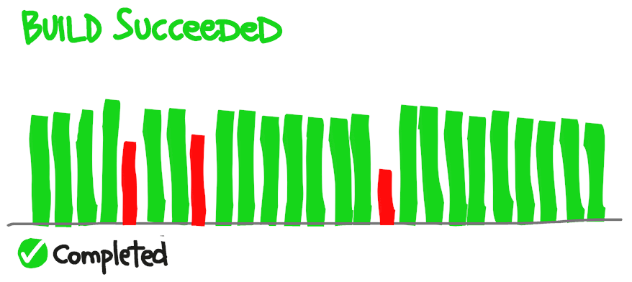
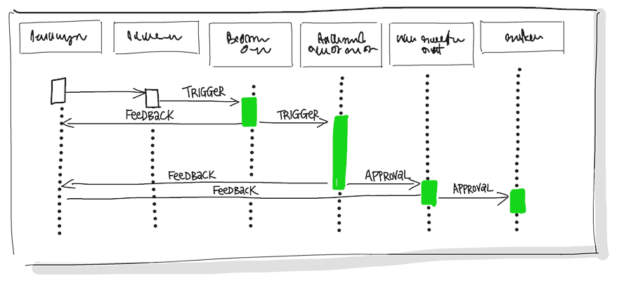
Explore the DevOps journey
Continuous Integration
Continuous Integration drives the ongoing merging and testing of code, which leads to finding defects early.
Continuous Delivery
Continuous Delivery of software solutions to production and testing environments helps organizations quickly fix bugs and respond to ever-changing business requirements.
Notes:
https://docs.microsoft.com/en-us/azure/devops/learn/what-is-devops
https://docs.microsoft.com/en-us/learn/modules/introduction-to-devops/3-explore-devops-journey
Continuous Integration drives the ongoing merging and testing of code, which leads to finding defects early. Other benefits include less time wasted on fighting merge issues and rapid feedback for development teams.
Continuous Delivery of software solutions to production and testing environments helps organizations quickly fix bugs and respond to ever-changing business requirements.

Slide 6
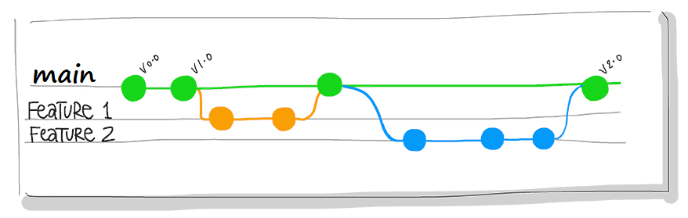
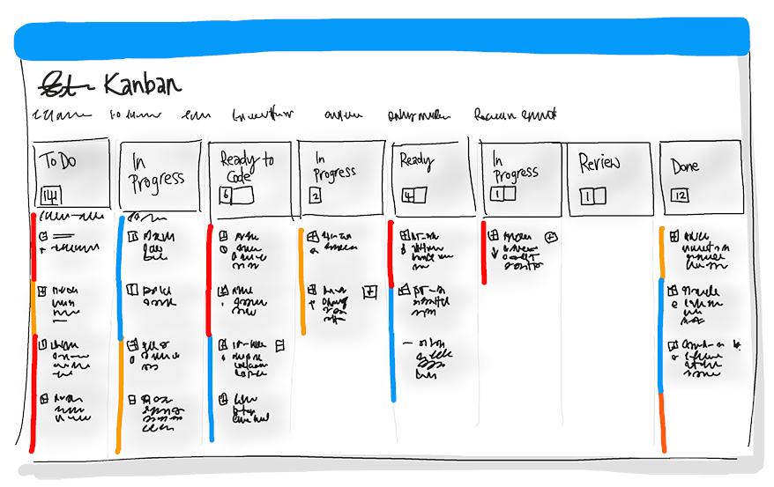
Explore the DevOps journey (continued)
Version Control
Version Control, usually with a Git-based Repository, enables teams located anywhere in the world to communicate effectively during daily development activities.
Agile/lean
Plan and isolate work into sprints.
Manage team capacity and help teams quickly adapt to changing business needs.
A DevOps Definition of Done is working software collecting telemetry against the intended business goals.
Notes:
https://docs.microsoft.com/en-us/azure/devops/learn/what-is-devops
https://docs.microsoft.com/en-us/learn/modules/introduction-to-devops/3-explore-devops-journey
Version Control, usually with a Git-based Repository, enables teams located anywhere in the world to communicate effectively during daily development activities. Also, integrate with software development tools for monitoring activities such as deployments.
Use Agile planning and lean project management techniques to:
Plan and isolate work into sprints.
Manage team capacity and help teams quickly adapt to changing business needs.
A DevOps Definition of Done is working software collecting telemetry against the intended business goals.

Slide 7
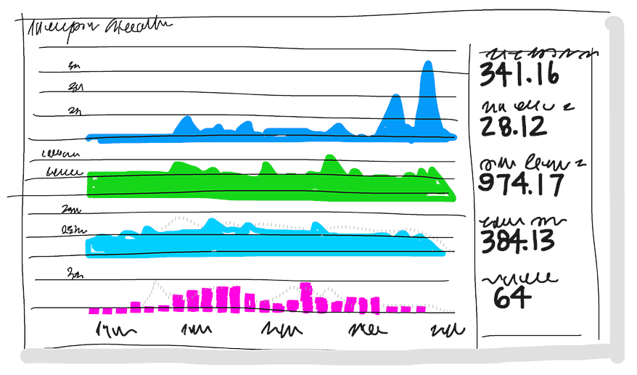
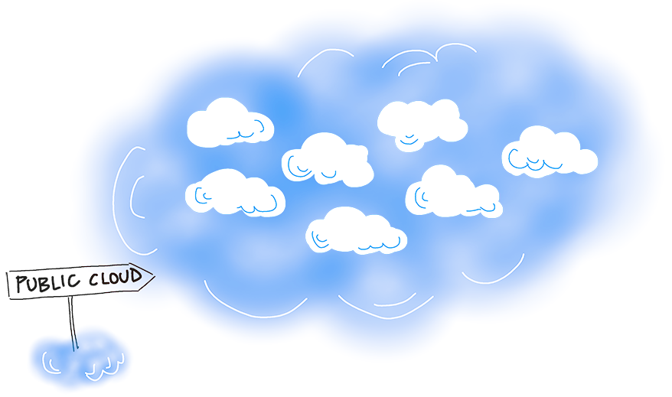
Explore the DevOps journey (continued)
Monitoring and logging
Monitoring and Logging of running applications.
Cloud
Public and Hybrid Clouds have made the impossible easy.
Notes:
https://docs.microsoft.com/en-us/azure/devops/learn/what-is-devops
https://docs.microsoft.com/en-us/learn/modules/introduction-to-devops/3-explore-devops-journey
Monitoring and Logging of running applications. Including production environments for application health and customer usage. It helps organizations create a hypothesis and quickly validate or disprove strategies. Rich data is captured and stored in various logging formats.
Public and Hybrid Clouds have made the impossible easy. The cloud has removed traditional bottlenecks and helped commoditize Infrastructure. You can use Infrastructure as a Service (IaaS) to lift and shift your existing apps or Platform as a Service (PaaS) to gain unprecedented productivity. The cloud gives you a data center without limits.

Slide 8
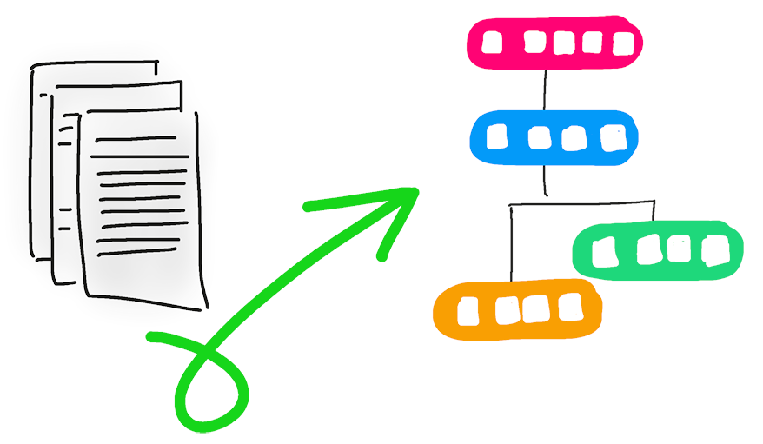
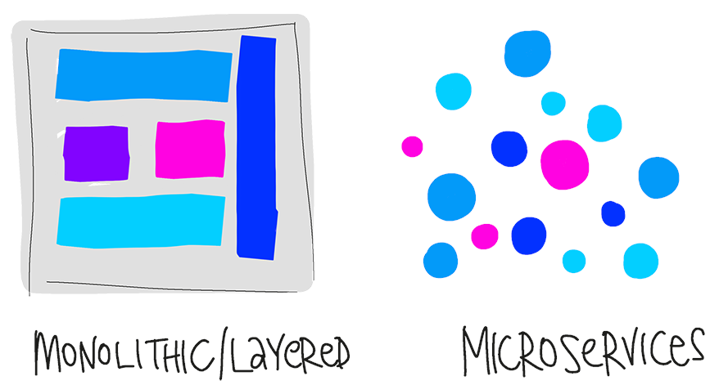
Explore the DevOps journey (continued)
Infrastructure as Code (IaC)
Enables the automation and validation of the creation and teardown of environments to help with delivering secure and stable application hosting platforms.
Microservices
Isolate business use cases into small reusable services that communicate via interface contracts.
Notes:
https://docs.microsoft.com/en-us/azure/devops/learn/what-is-devops
https://docs.microsoft.com/en-us/learn/modules/introduction-to-devops/3-explore-devops-journey
Infrastructure as Code (IaC): Enables the automation and validation of the creation and teardown of environments to help with delivering secure and stable application hosting platforms.
Use Microservices architecture to isolate business use cases into small reusable services that communicate via interface contracts. This architecture enables scalability and efficiency.

Slide 9
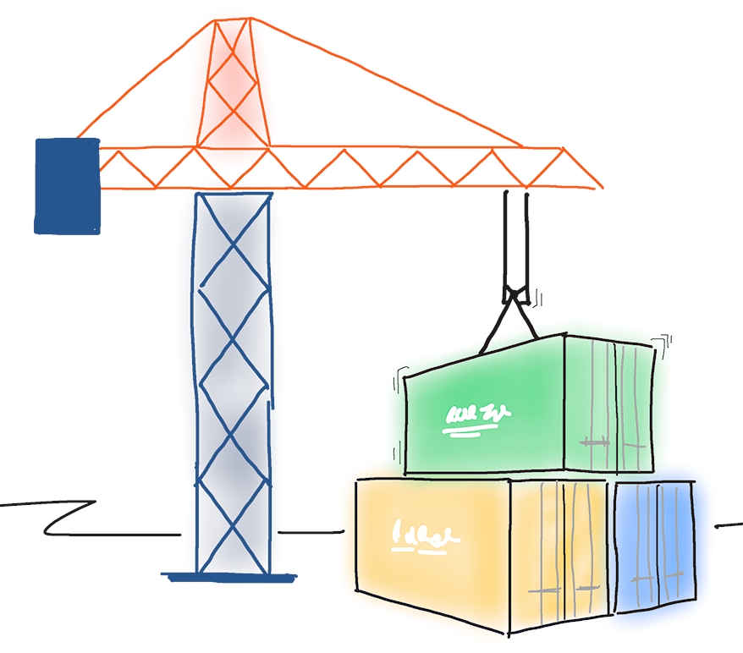
Explore the DevOps journey (continued)
Containers
Containers are the next evolution in virtualization.
DevOps may hurt at first
Notes:
https://docs.microsoft.com/en-us/azure/devops/learn/what-is-devops
https://docs.microsoft.com/en-us/learn/modules/introduction-to-devops/3-explore-devops-journey
Containers are the next evolution in virtualization. They are much more lightweight than virtual machines, allow much faster hydration, and easily configure files.
DevOps may hurt at first.
If it hurts, do it more often. Just like going to the gym, adopting new practices is likely to hurt at first. The more often you exercise the new techniques, the easier they will become.
Like training at the gym, where you first exercise large muscles before small muscles, adopt practices that have the most significant impact. Cross-train to develop synergy.

Slide 10
Module 03: Design and implement branch strategies and workflows

Slide 11
What is source control?
1
A source control system allows developers to collaborate on code and track changes. Use version control to save your work and coordinate code changes across your team.
2
The version control system saves a snapshot of your files (history) so that you can review and even roll back to any version of your code with ease.
3
Source control protects source code from catastrophe and the casual degradation of human error and unintended consequences.

Slide 12
Explore branch workflow types
1
Feature branching – All feature development should take place in a dedicated branch instead of the main branch.
2
Forking Workflow – Every developer uses a server-side repository.
3
Evaluate the workflow:
Does this workflow scale with team size?
Is it easy to undo mistakes and errors with this workflow?
Does this workflow impose any new unnecessary cognitive overhead to the team?

Slide 13
Explore feature branch workflow
Create a branch
Add commits
Open a pull request
Discuss and review your code
Deploy
Merge
All feature development should take place in a dedicated branch instead of the main branch.
Encapsulating feature development leverages pull requests, which are a way to initiate discussions around a branch.
Share a feature with others without touching any official code.

Slide 14
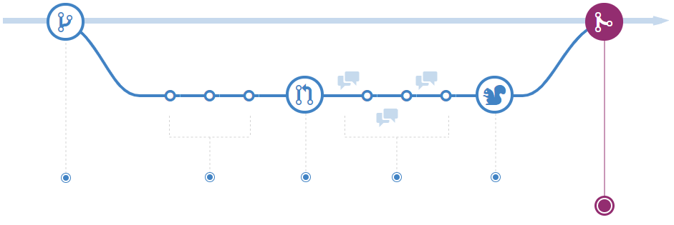
Explore GitHub flow
Make changes
Create a pull request
Delete your branch
Address review comments
Merge your pull request
Create a branch
GitHub Flow is a lightweight, branch-based workflow. The GitHub flow is useful for everyone, not just developers
Notes:
More details: https://docs.microsoft.com/en-us/learn/modules/manage-git-branches-workflows/5-explore-feature-branch-workflow and https://docs.github.com/en/get-started/quickstart/github-flow
Describe the GitHub flow and its steps. From above references:
GitHub is the best tool to enable collaboration in your projects. GitHub flow is a branch-based workflow suggested for GitHub.
To implement GitHub flow, you'll need a GitHub account and a repository. See https://github.com/signup and https://docs.github.com/en/get-started/quickstart/create-a-repo. You can complete all steps of GitHub flow through the GitHub web interface, command line, https://cli.github.com/, or https://desktop.github.com/.
The first step is to create a branch in your repository to work without affecting the default branch, and you give collaborators a chance to review your work. For more information, see https://docs.github.com/en/enterprise-server@3.1/pull-requests/collaborating-with-pull-requests/proposing-changes-to-your-work-with-pull-requests/creating-and-deleting-branches-within-your-repository.
Make any desired changes to the repository. If you make a mistake, you can revert or push extra changes to fix it.
Commit and push your changes to your branch to back up your work to remote storage, giving each commit a descriptive message. Each commit should contain an isolated, complete change making it easy to revert if you take a different approach.
Anyone collaborating with your project can see your work, answer questions, and make suggestions or contributions. Continue to create, commit, and push changes to your branch until you're ready to ask for feedback.
You can make a separate branch for each change to make it easy for reviewers to give feedback or for you to understand the differences. Once you're ready, you can create a pull request to ask collaborators for feedback on your changes. See https://docs.github.com/en/pull-requests/collaborating-with-pull-requests/proposing-changes-to-your-work-with-pull-requests/creating-a-pull-request.
Pull request review is one of the most valuable features of collaboration. You can require approval from your peers and team before merging changes. Also, you can mark it as a draft in case you want early feedback or advice before you complete your changes.
Describe the pull request as much as possible with the suggested changes and what problem you're resolving. You can add images, links, related issues, or any information to document your change and help reviewers understand the PR without opening each file. See https://docs.github.com/en/get-started/writing-on-github/getting-started-with-writing-and-formatting-on-github/basic-writing-and-formatting-syntax and https://docs.github.com/en/issues/tracking-your-work-with-issues/linking-a-pull-request-to-an-issue.
Another way to improve PR quality and documentation and explicitly point something out to the reviewers is to use the comment session area. Also, you can @mention or request a review from specific people or teams.
There are other Pull Requests configurations, such as automatically requesting a review from specific teams or users when a pull request is created or checks to run on pull requests. For more information, see https://docs.github.com/en/pull-requests/collaborating-with-pull-requests/collaborating-on-repositories-with-code-quality-features/about-status-checks and https://docs.github.com/en/repositories/configuring-branches-and-merges-in-your-repository/defining-the-mergeability-of-pull-requests/about-protected-branches.
After the reviewers' comments and checks validation, the changes should be ready to be merged, and they can approve the Pull Request. See https://docs.github.com/en/pull-requests/collaborating-with-pull-requests/incorporating-changes-from-a-pull-request/merging-a-pull-request.
If you have any conflicts, GitHub will inform you to resolve them. https://docs.github.com/en/pull-requests/collaborating-with-pull-requests/addressing-merge-conflicts
After a successful pull request merges, there's no need for the remote branch to stay there. You can delete your branch to prevent others from accidentally using old branches. For more information, see https://docs.github.com/en/repositories/configuring-branches-and-merges-in-your-repository/managing-branches-in-your-repository/deleting-and-restoring-branches-in-a-pull-request
GitHub keeps the commit and merges history if you need to restore or revert your pull request.

Slide 15

Explore fork workflow
1
Forking workflow gives every developer their own server-side repository
2
Each contributor has not one, but two Git repositories: a private local one and a public server-side one
3
Most often seen in public open-source projects
4
Contributions can be integrated without the need for everybody to push to a single central repository
Forked repositories use the standard git clone command

Slide 16
Implement branch merging restrictions
Azure DevOps:
Using branch protection-based policies
Require a minimum number of reviewers
Check for linked work items
Check for comment resolution
Limit merge types
Locking a branch
GitHub:
Using branch protection rules
Require a pull request before merging
Require status checks to pass before merging
Require conversation resolution before merging
Require signed commits
Require deployments to succeed before merging
Notes:
Azure DevOps:
Optionally, you can configure the following constraints:
Build validation: validates code by pre-merging and building pull request changes.
Status checks: require other services to post successful status to complete pull requests.
Automatically include reviewers: designate code reviewers to automatically include when pull requests change certain areas of code.
GitHub
Require linear history
Lock the branch
Do not allow by passing the above settings
Allow force pushes
Allow deletions

Slide 17
Module 04: Collaborate with pull requests in Azure Repos

Slide 18
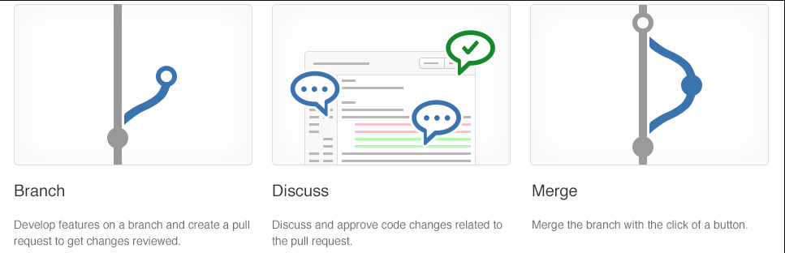
Collaborate with pull requests
Pull requests let you tell others about changes.
Collaboration using the Shared Repository Model
Review and merge your code in a single collaborative process.
Be sure to provide good feedback and protect branches with policies.

Slide 19
Module 05: Explore Git hooks

Slide 20
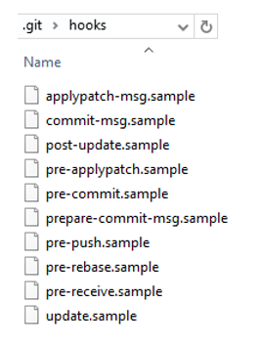
Introduction to Git hooks
A mechanism that allows arbitrary code to be run before, or after, certain Git lifecycle events occur
Use Git hooks to enforce policies, ensure consistency, and control your environment
Can be either client-side or server-side

Slide 21
Implement Git hooks
Will my code:
Break other code?
Introduce code quality issues?
Drop the code coverage?
Take on a new dependency?
Will the incoming code:
Break my code?
Introduce code quality issues?
Drop the code coverage?
Take on a new dependency?

Slide 22
Module 07: Manage and configure repositories

Slide 23
Work with large repositories
1
Two common causes: Long history and large binary files
2
Long history: Use shallow clones git clone –depth [depth] [clone-url]
3
Large binary files: Use Git Large File Storage (LFS)
Notes:
https://git-lfs.github.com/

Slide 24
Implement Scalar and cross repo when cross repo sharing
Techniques:
Scalar
.NET Core application and Git extension
Caches metadata and uses background maintenance
Cross repository sharing
Reuses code and resources across multiple Git repositories
Key considerations:
Implement Scalar for large repositories
Optimize repository structure
Break down large repositories into smaller ones
Adopt a modular approach
Use Git submodules and Git sub repositories
Register, Pause, Unregister: scalar [register][pause][unregister]
1
2
Run and Clone: scalar [run all], scalar [clone URL]
Notes:
Explain core concepts around Scalar and basic commands.
Scalar is a .NET Core application available for Windows and macOS with tools and extensions for Git to allow very large repositories to maximize your Git command performance.
If Azure Repos hosts your repository, you can clone a repository using the https://github.com/microsoft/VFSForGit/blob/master/Protocol.md. This is how Microsoft supports Windows and Office repositories.
Scalar is a tool that helps Git scale to some of the largest Git repositories. It achieves this by enabling some advanced Git features, such as:
Partial clone: reduces time to get a working repository by not downloading all Git objects right away.
Background prefetch: downloads Git object data from all remotes every hour, reducing the time for foreground git fetch calls.
Sparse-checkout: limits the size of your working directory.
File system monitor: tracks the recently modified files and eliminates the need for Git to scan the entire work tree.
Commit-graph: accelerates commit walks and reachability calculations, speeding up commands like git log.
Multi-pack-index: enables fast object lookups across many pack files.
Incremental repack: Repacks the packed Git data into fewer pack files without disrupting concurrent commands using the multi-pack-index.
Scalar repository: https://github.com/microsoft/scalar
More details about Scalar: https://devblogs.microsoft.com/devops/introducing-scalar/

Slide 25
Explore monorepo versus multiple repos
1
Monorepos – Source control pattern where all the source code is kept in a single repository.
2
Multiple repositories – Refer to organizing your projects each into their separate repository.
A repository is a place where the history of your work is stored.
Azure DevOps projects can contain multiple repositories. There are two philosophies on organizing your repos: Monorepo or Multiple repos.
The fundamental difference between the monorepo and multiple repos philosophies boils down to a difference about what will allow teams working together on a system to go fastest.
Notes:
Explain the difference between monorepo versus multiple repos.
There are two philosophies on organizing your repos: Monorepo or Multiple repos.
Monorepos is a source control pattern where all the source code is kept in a single repository. It's super simple to give all your employee's access to everything in one shot. Just clone it down and done.
Multiple repositories refer to organizing your projects each into their separate repository.
The fundamental difference between the monorepo and multiple repos philosophies boils down to a difference about what will allow teams working together on a system to go fastest.
The multiple repos view, in extreme form, is that if you let every subteam live in its repo.

Slide 26
Implement a change log
1
Track changes to a project over versions.
For each version, record:
New functionality
Changed functionality
Removed functionality
2
Preference is to always avoid dumping log entries into a change log.
Logs are “noisy,” and so it’s easy to generate a mess that is not helpful.
3
Can be manually created
Can be automatically populated
Can be a combination of both
Auto:
git log
gitchangelog
github_changelog_generator
git log [options] vX.X.X..vX.X.Y | helper-script > projectchangelogs/X.X.Y

Slide 27
Purge repository data
Might need to delete files from repository:
Use:
Reduce repository size
Remove accidentally committed large file
Remove committed file with sensitive data (passwords, keys)
git filter-repo tool
BFG Repo-Cleaner
Example:
$ bfg --delete-files file_I_should_not_have_committed
$ bfg --replace-text passwords.txt
Notes:
https://github.com/newren/git-filter-repo/
git filter-branch has a plethora of pitfalls that can produce non-obvious mangling's of the intended history rewrite (and can leave you with little time to investigate such problems since it has such abysmal performance). These safety and performance issues cannot be backward compatibly fixed and as such, its use is not recommended. Please use an alternative history filtering tool such as https://github.com/newren/git-filter-repo.
git filter-repo is a versatile tool for rewriting history, which includes https://github.com/newren/git-filter-repo#design-rationale-behind-filter-repo. It roughly falls into the same space of tool as https://git-scm.com/docs/git-filter-branch but without the capitulation-inducing poor performance, with far more capabilities, and with a design that scales usability-wise beyond trivial rewriting cases. git filter-repo is now recommended by the git project https://github.com/newren/git-filter-repo instead of git filter-branch.

Slide 28
Recover specific data by using Git commands
Recovering commits:
git logs
git checkout <commit>
git cherry-pick <commit>
Recovering specific lines of code:
git blame <file>
git show <commit>:<file>
Recovering files:
git checkout <commit> <file>
git restore <file>
Recovering deleted commits or branches:
git reflog
git fsck—lost-found
Notes:
Remember to use these commands with caution, especially when manipulating commit history or reverting changes. Always make sure to create a backup of your repo before you start or use git stash to save your current changes before attempting any recovery operations.

Slide 29
Implement automation of Git history documentation
1
Automate API documentation generation: Use OpenAI or other API documentation tools and integrate this process into your CI/CD pipeline
2
Generate release notes from Git history: Use Git commands or tools like GitChangelog and customize the release note format
3
Include Git history in release documentation: Use Markdown or other documentation format to structure and present the Git history
4
Integrate release notes into documentation pipeline: Use scripting or automation tools like Azure Pipelines or GitHub Actions to trigger the generation of release notes
5
Automate documentation publishing: Publish to a central location accessible to all teams and stakeholders, such as GitHub Pages, Azure DevOps wikis, or other documentation hosting services

